Slide 1
USAWOA 50th Annual Meeting of the Members
Executive Director’s Report

Slide 2
Revenue Generation/Savings
National and Regional Leaders’ expenses and salary
Membership Enhancement Project (MEP)
USAWOA Now A 501(c)(19) Nonprofit VSO
CW5 (Ret) Phyllis Wilson
Recruiting and Retention: We Are Failing!!

Slide 3
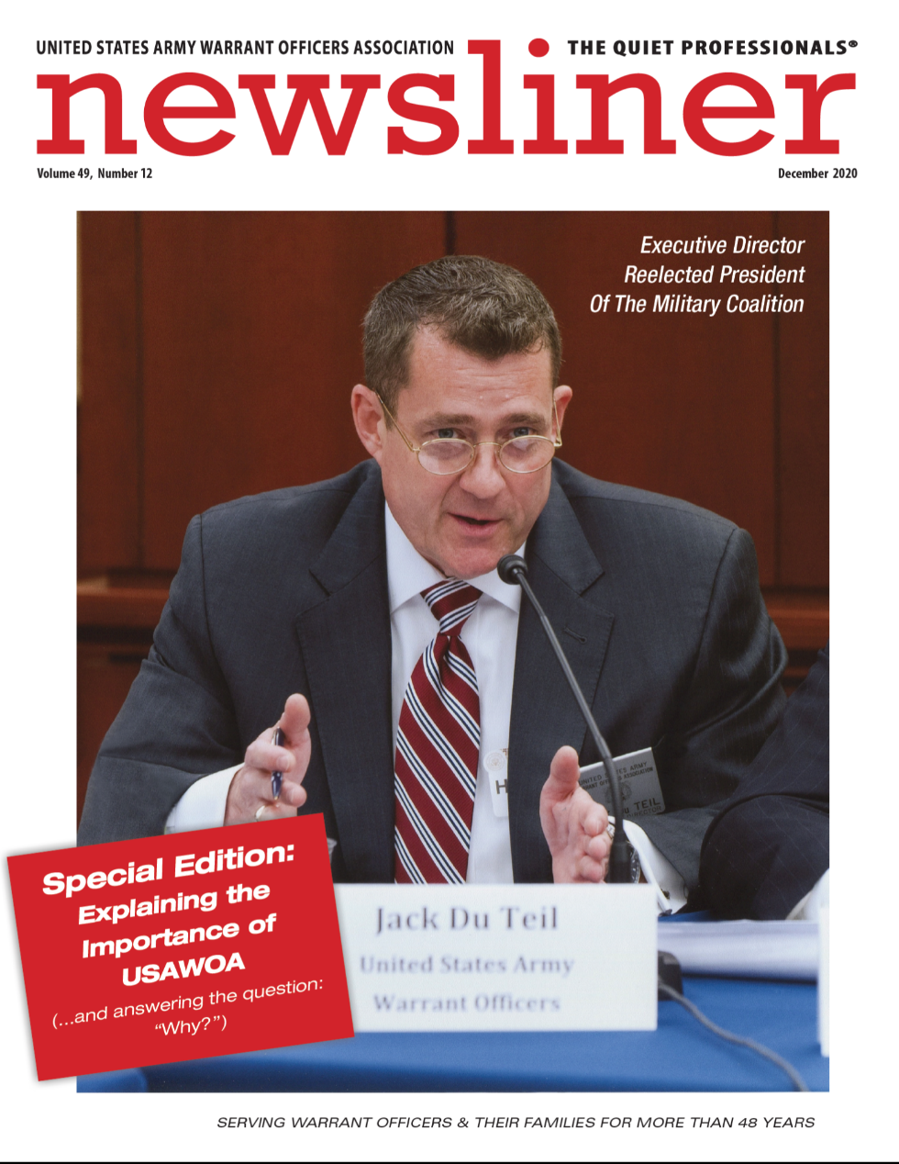
Newsliner Special Edition

Slide 4
Representation
USAWOA/Senior WO Leaders
The Military Coalition (TMC)
  USAWOA National Executive Director Running For Third Term As President of TMC
  USAWOA on Four TMC Committees (Personnel, G&R, Nominations, Awards)
Service Member Pay and Benefits; Veterans
  Pay
  BAH
  TRICARE and TRICARE Pharmacy
  Commissary
  Incentive Pays Parity – Victory…Sort Of…
  Toxic Exposure Presumptives – Victory: PACT ACT!
  Concurrent Receipt: MAJ Richard Star Act!
  Concern: Use of Continuing Resolutions…☹
  Concern: Inflation and Potential Fight on COLAs…☹
SUPPORT OUR CALLS TO ACTION, VIA EMAIL AND FACEBOOK!!
Continuing Senior Leader Support of Annual Meetings

Slide 5
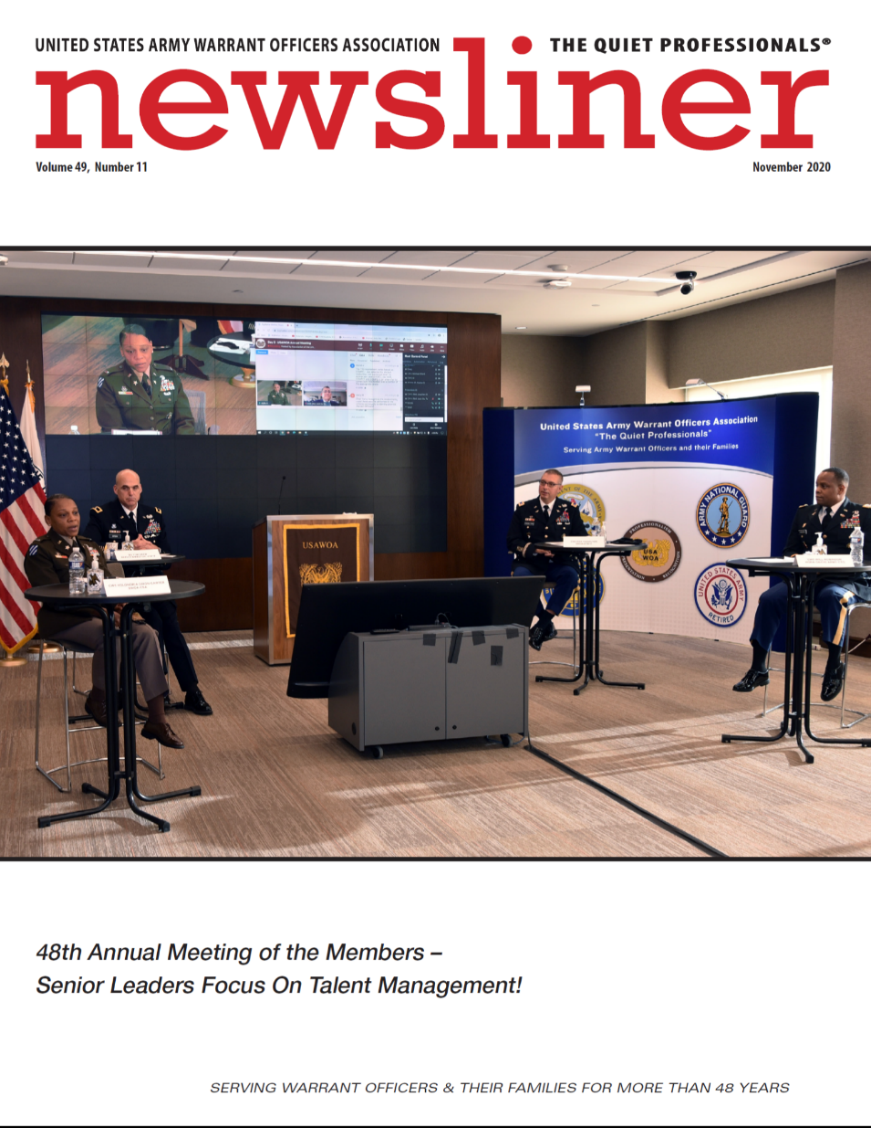
Senior Leader Support

Slide 6
Future Executive Director
Jack Du Teil Retires
31 December 2022

Slide 7
Future National Executive Director (NED)
Position Announcement Remains Open Until Filled!
Jack Retires, But Continues Part-time
  Paid $2,080 per month on a 1099-basis, until new NED is hired, or until November 2024
  Jack will run for third (and final) term as TMC President (term ending in November 2024)
  USAWOA hires professional editor to edit Newsliner magazine (Jack continues to control content).
Bottom Line:
  Annual Cost of Jack’s Contract: $24,960 (versus $60,000/year salary)
  Approximate Annual Cost of Newsliner Editor: $10,000
  Approximate Annual Savings to USAWOA: $25,040
Reality Check:
  As soon as a new NED is identified and hired, Jack will immediately terminate his “1099 contract relationship” with USAWOA, and continue as an unpaid mentor to the new NED for as long as it takes to mentor our new day-to-day leader of USAWOA (and that commitment is timeless…)
  If no new NED is identified by 7 November 2024 (end of Jack’s third term as TMC President), USAWOA becomes an organization without a fulltime day-to-day leader…

Slide 8
Question
  What Really Matters To You? Do You Want To Make Lot’s Of Money?
  Or Can You Afford To Take A Chance, And Make A Difference?

Slide 9
Question
Who Will Advocate For Us, When Our Service Organizations Are Gone…?

Slide 10
Questions?

